Slide 1
Screenshots for hw4
By: Alexander W. Wright

Slide 2
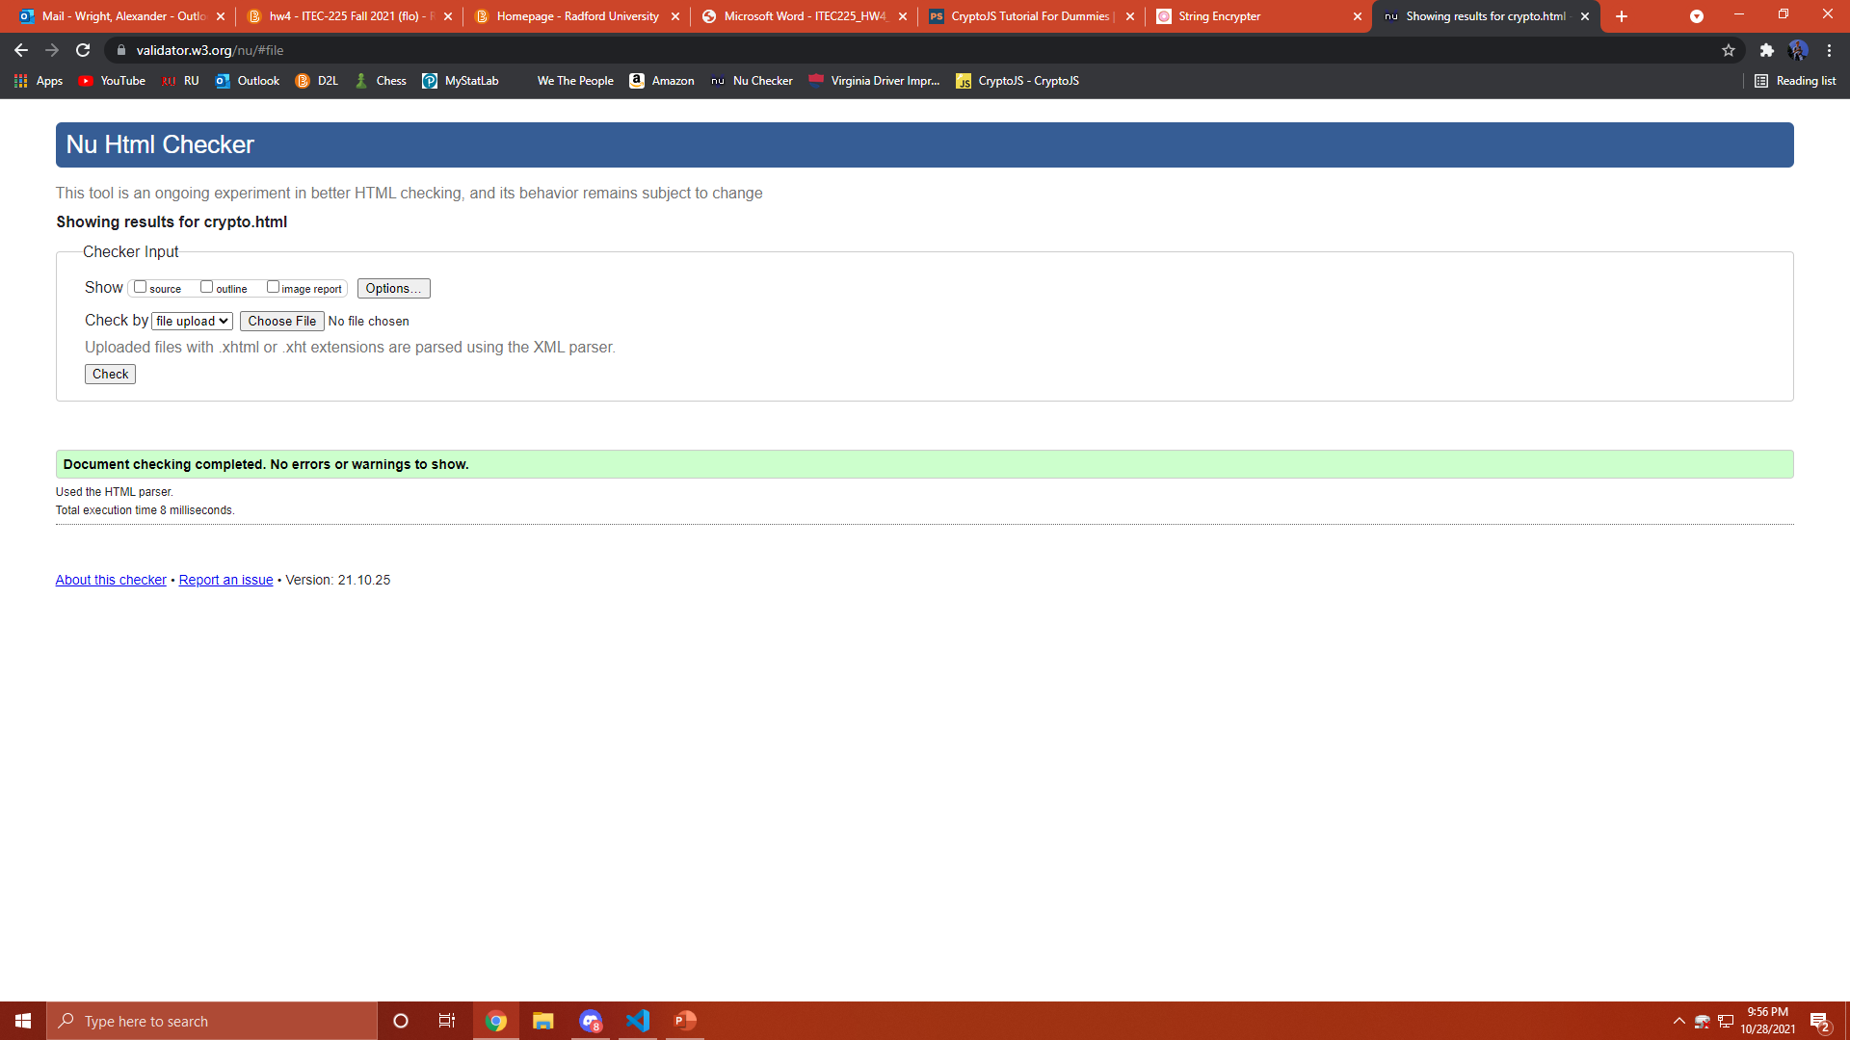
Screenshot #1 Nu checker passed

Slide 3
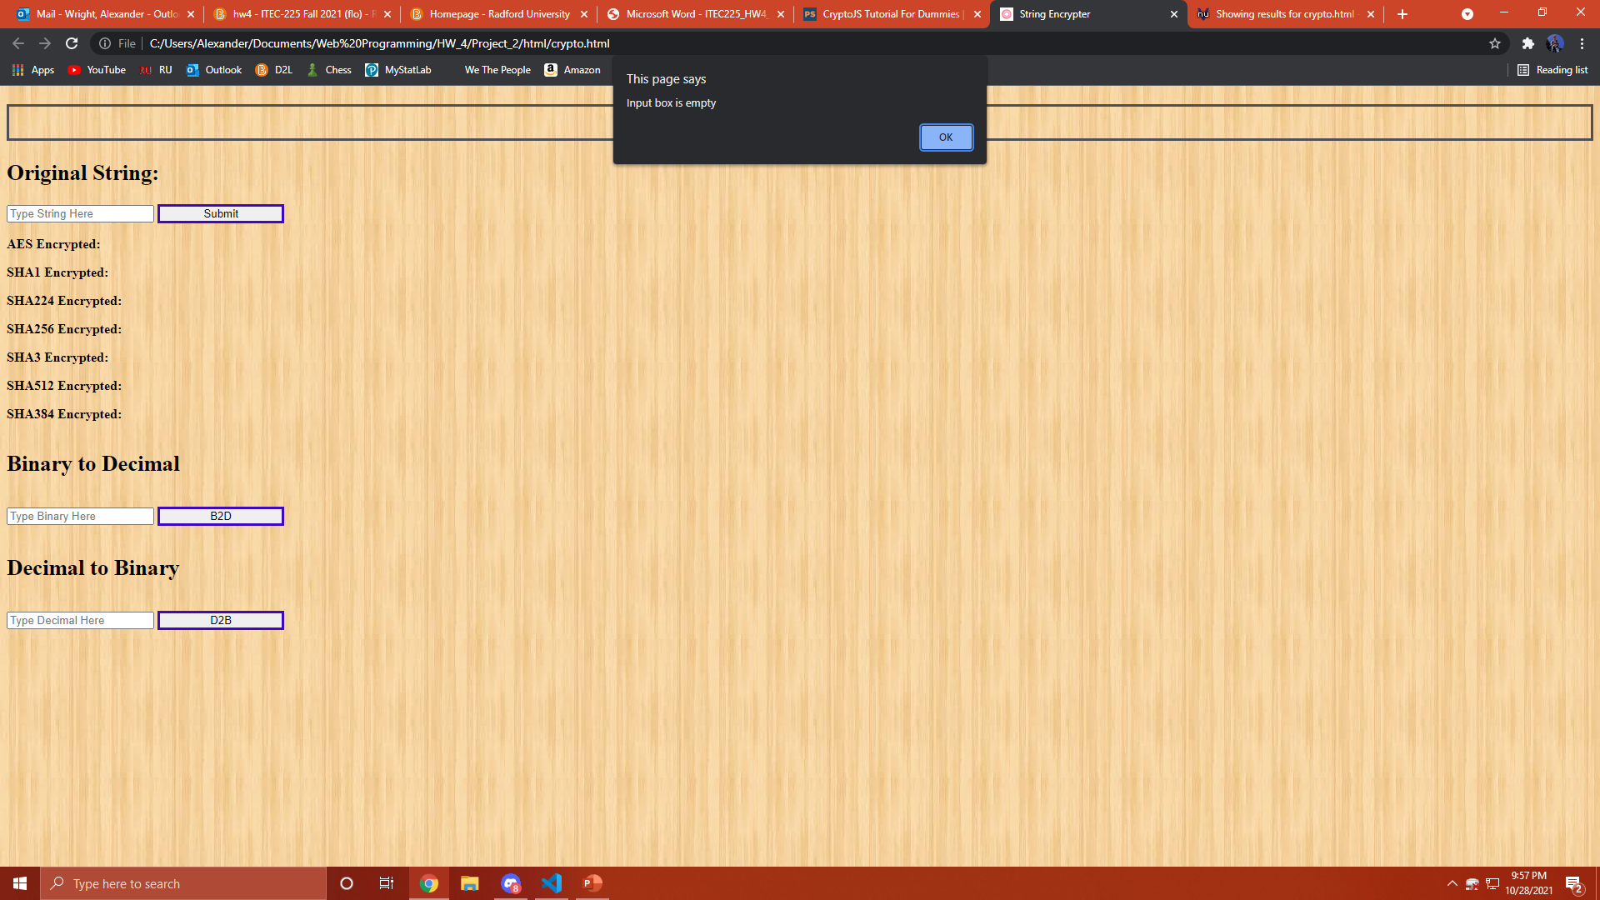
Screenshot #2 empty box

Slide 4
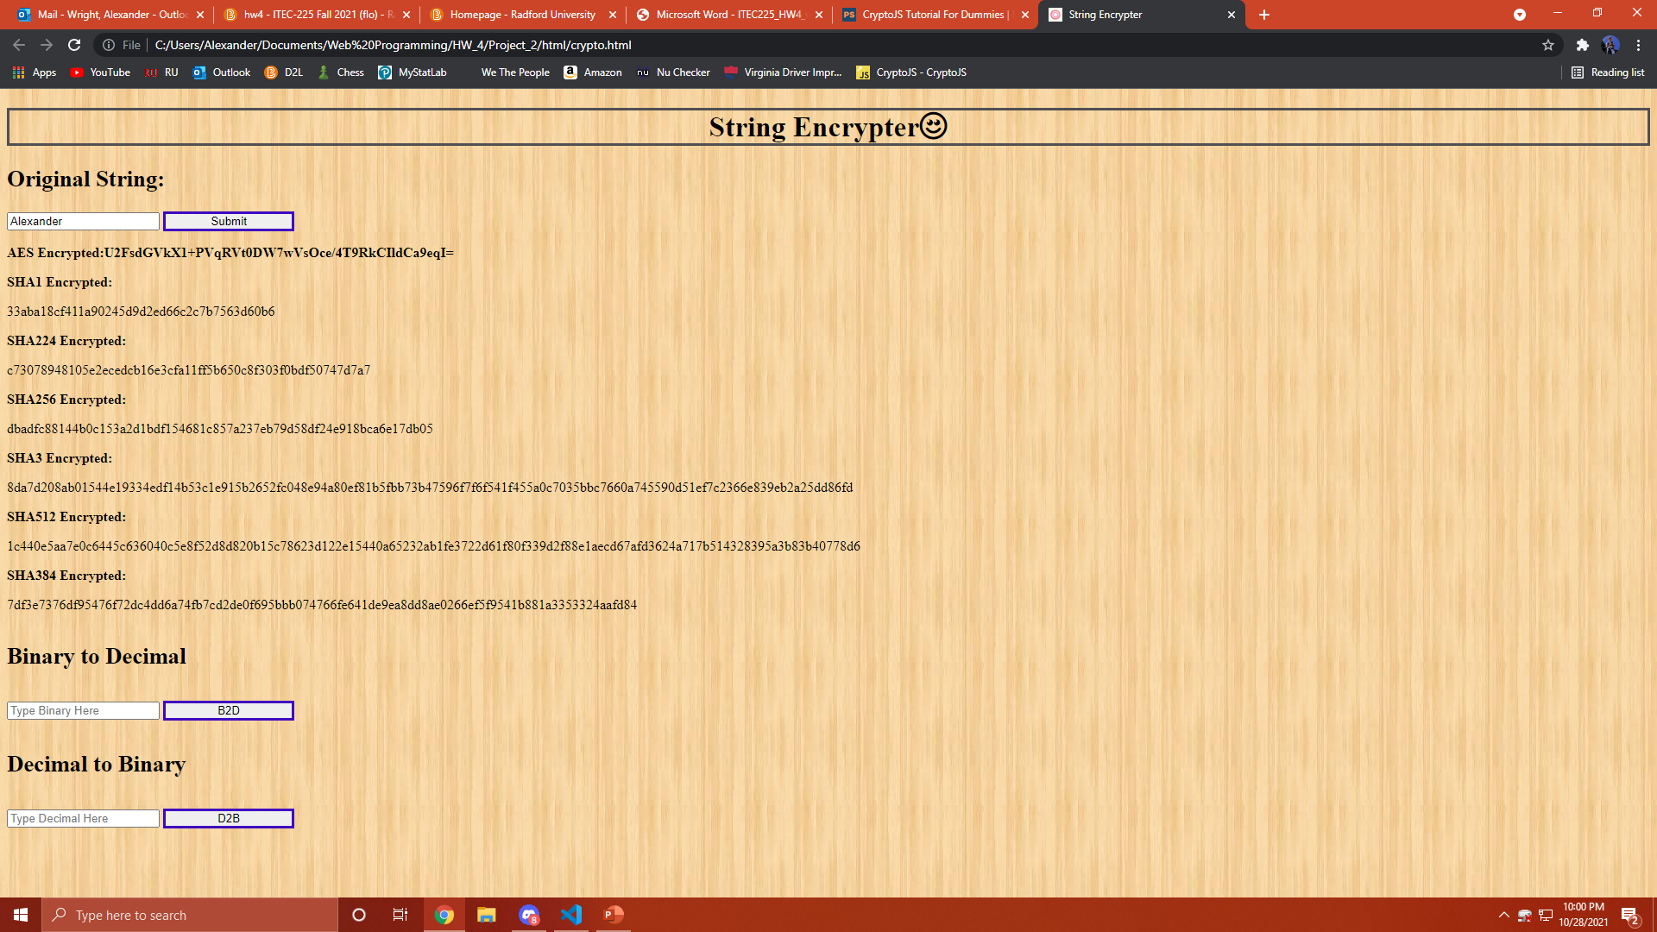
Screenshot #3 encryption

Slide 5
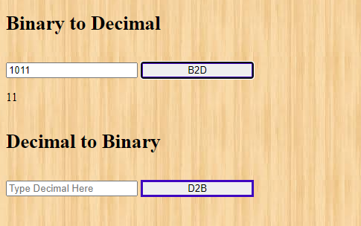
Screenshot #4 Binary to Decimal

Slide 6

Screenshot #5 Decimal to Binary

